Slide 1
EECT/CE 6325 Final Project(4-bit calculation)
Xiongtao Zhang
yuyang hsieh

Slide 2
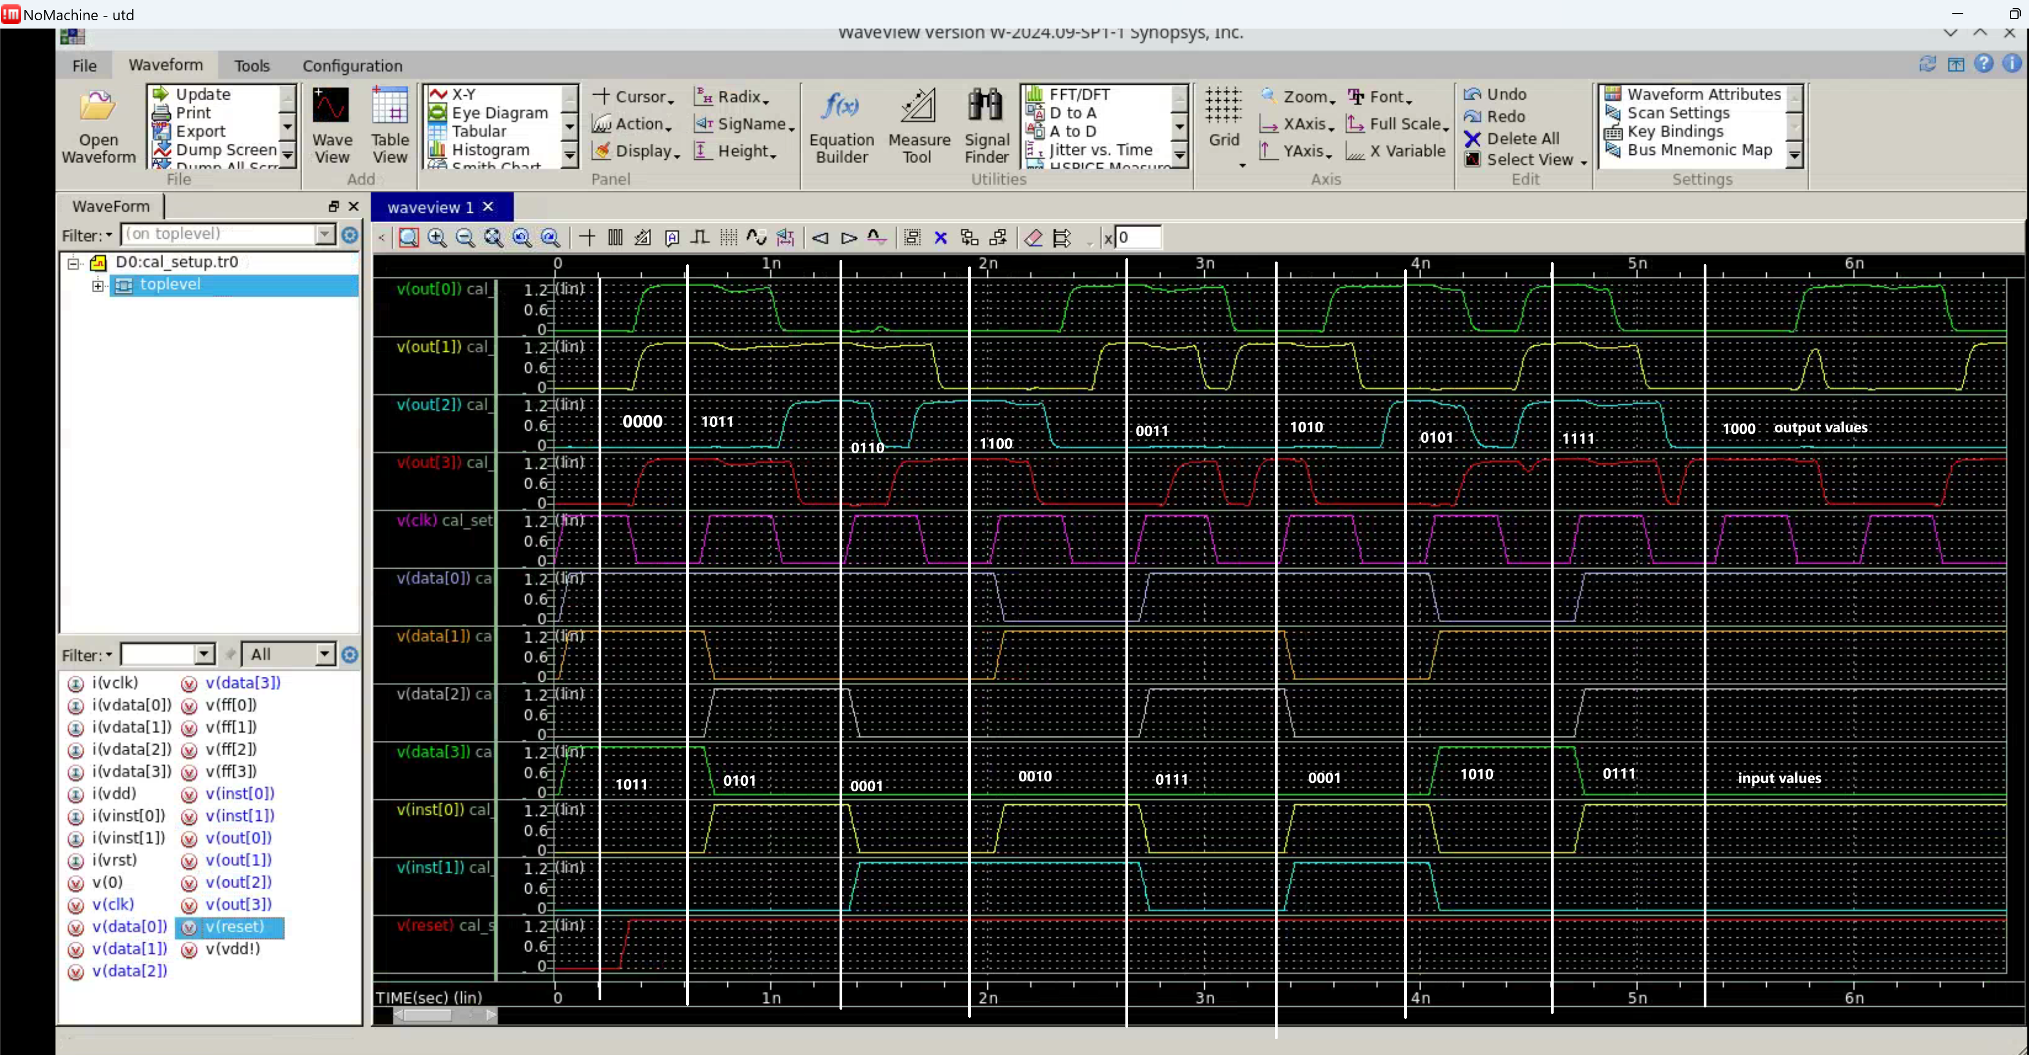
Functionality
the output waveforms simulated by HSPICE meet all the expected value and all processing completed within one clock cycle

Slide 3
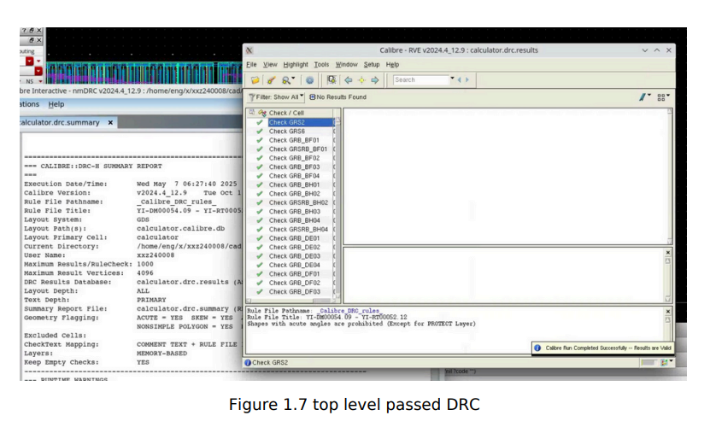
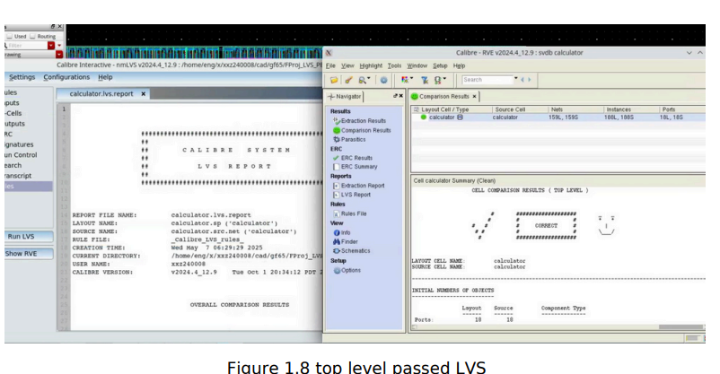
LVS + DRC passed

Slide 4
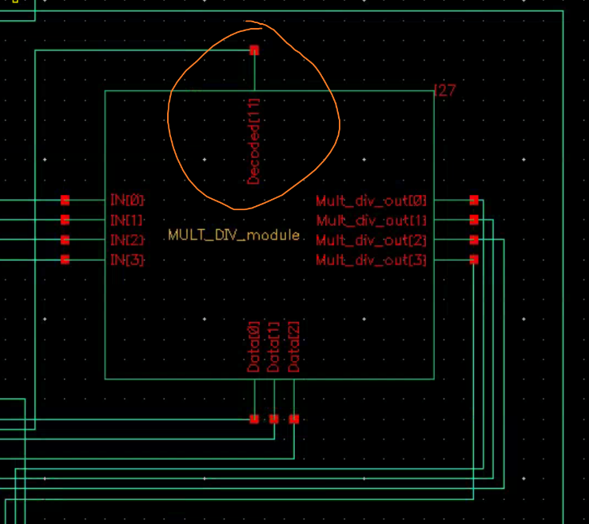
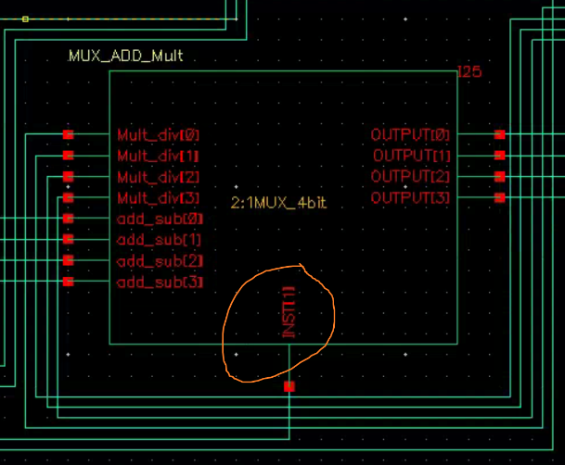
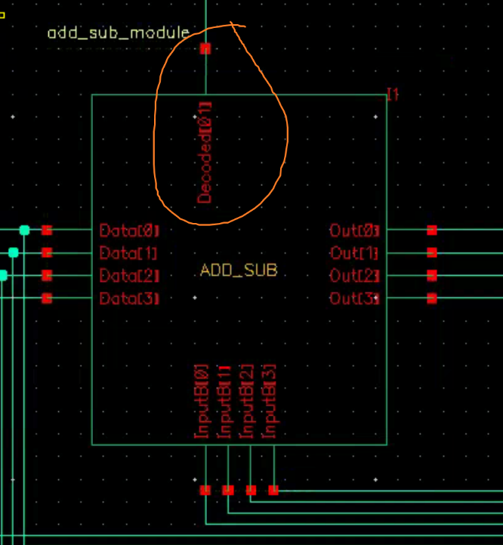
Design choices
The design contains 2 computation modules to perform addition, subtraction, multiplication, division; 1 MUX to select output result from computation modules; 1 Flipflop module to retain previous result; 1 reset module to reset the value in flipflop to all zero; 1 buffer module between Flipflop module and computation modules to improve the performance of driving fanout circuits.

Slide 5
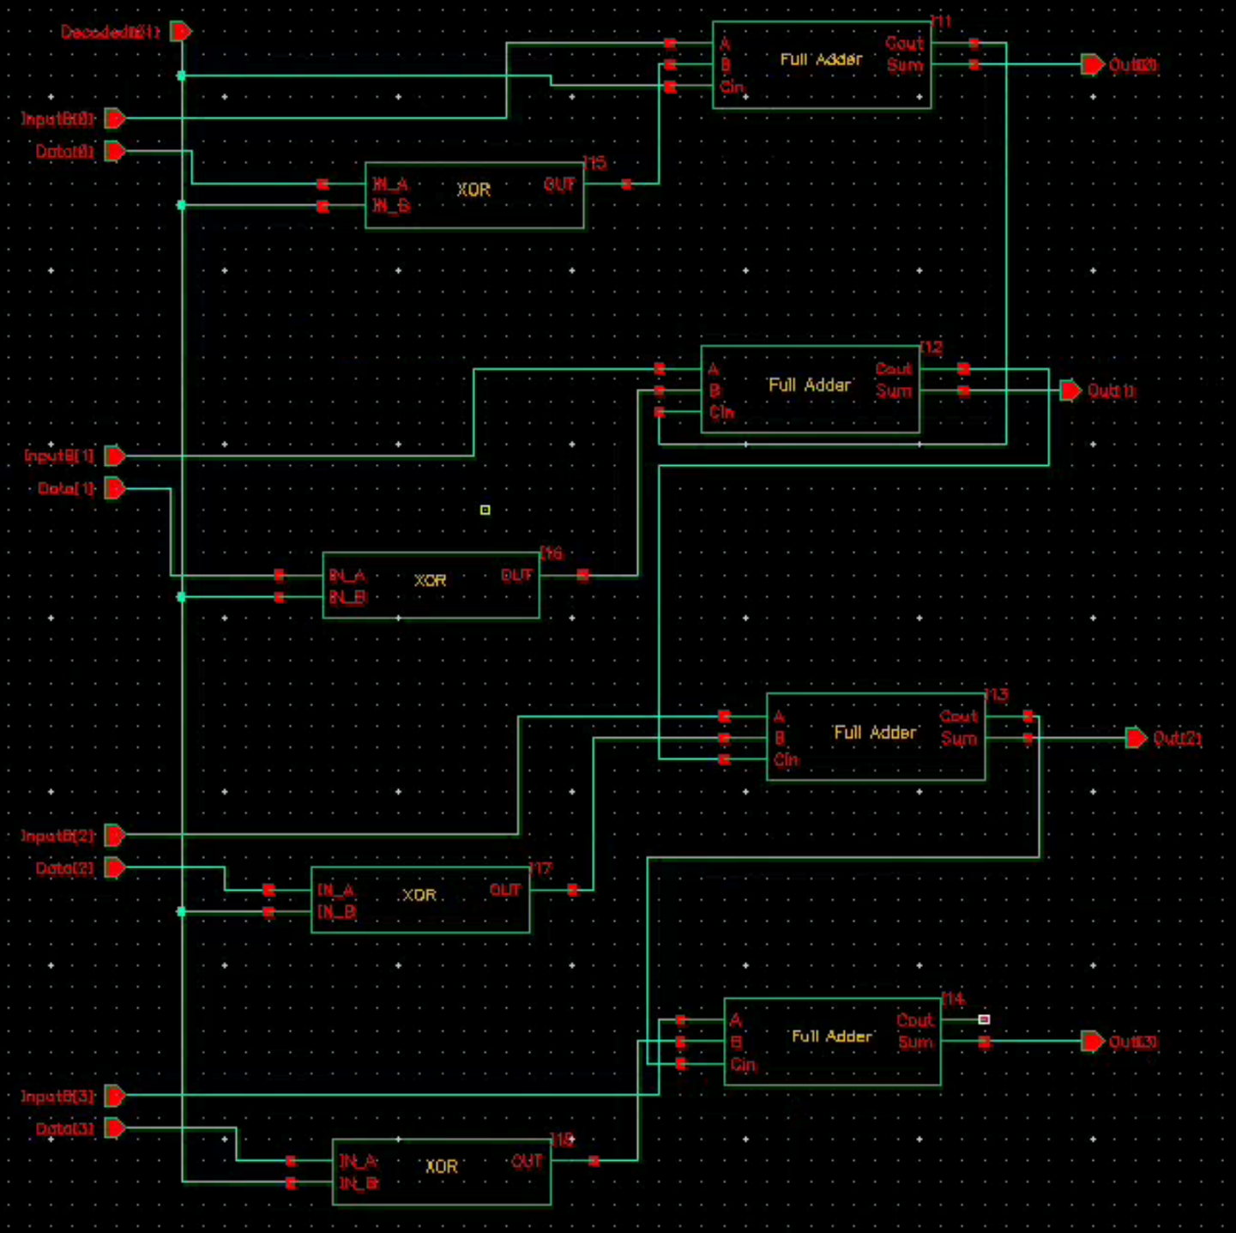
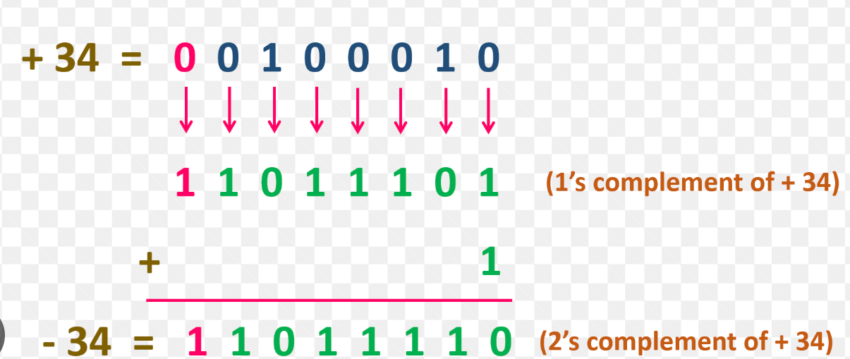
Add/sub
4-bit carry-ripple adder

Slide 6
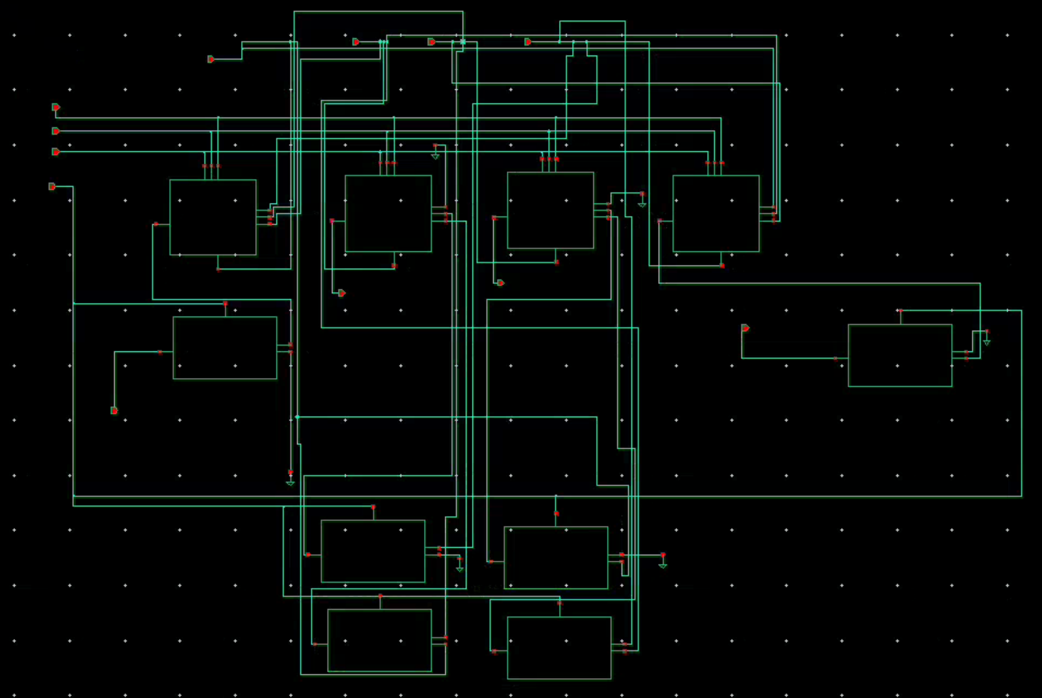
Mult/div
funnel shifter

Slide 7
Optimization
Optimize and reduce redundant modules/circuits. E.g1. In initial design, a decoder is used. But after finish the design of add_sub module and mult_div module, there is no need to contain a decoder in the circuit since the INST[0] bit can select add/sub or mult/div in each module. And INST[1] can select add_sub or mult_div in the MUX to provide output.

Slide 8
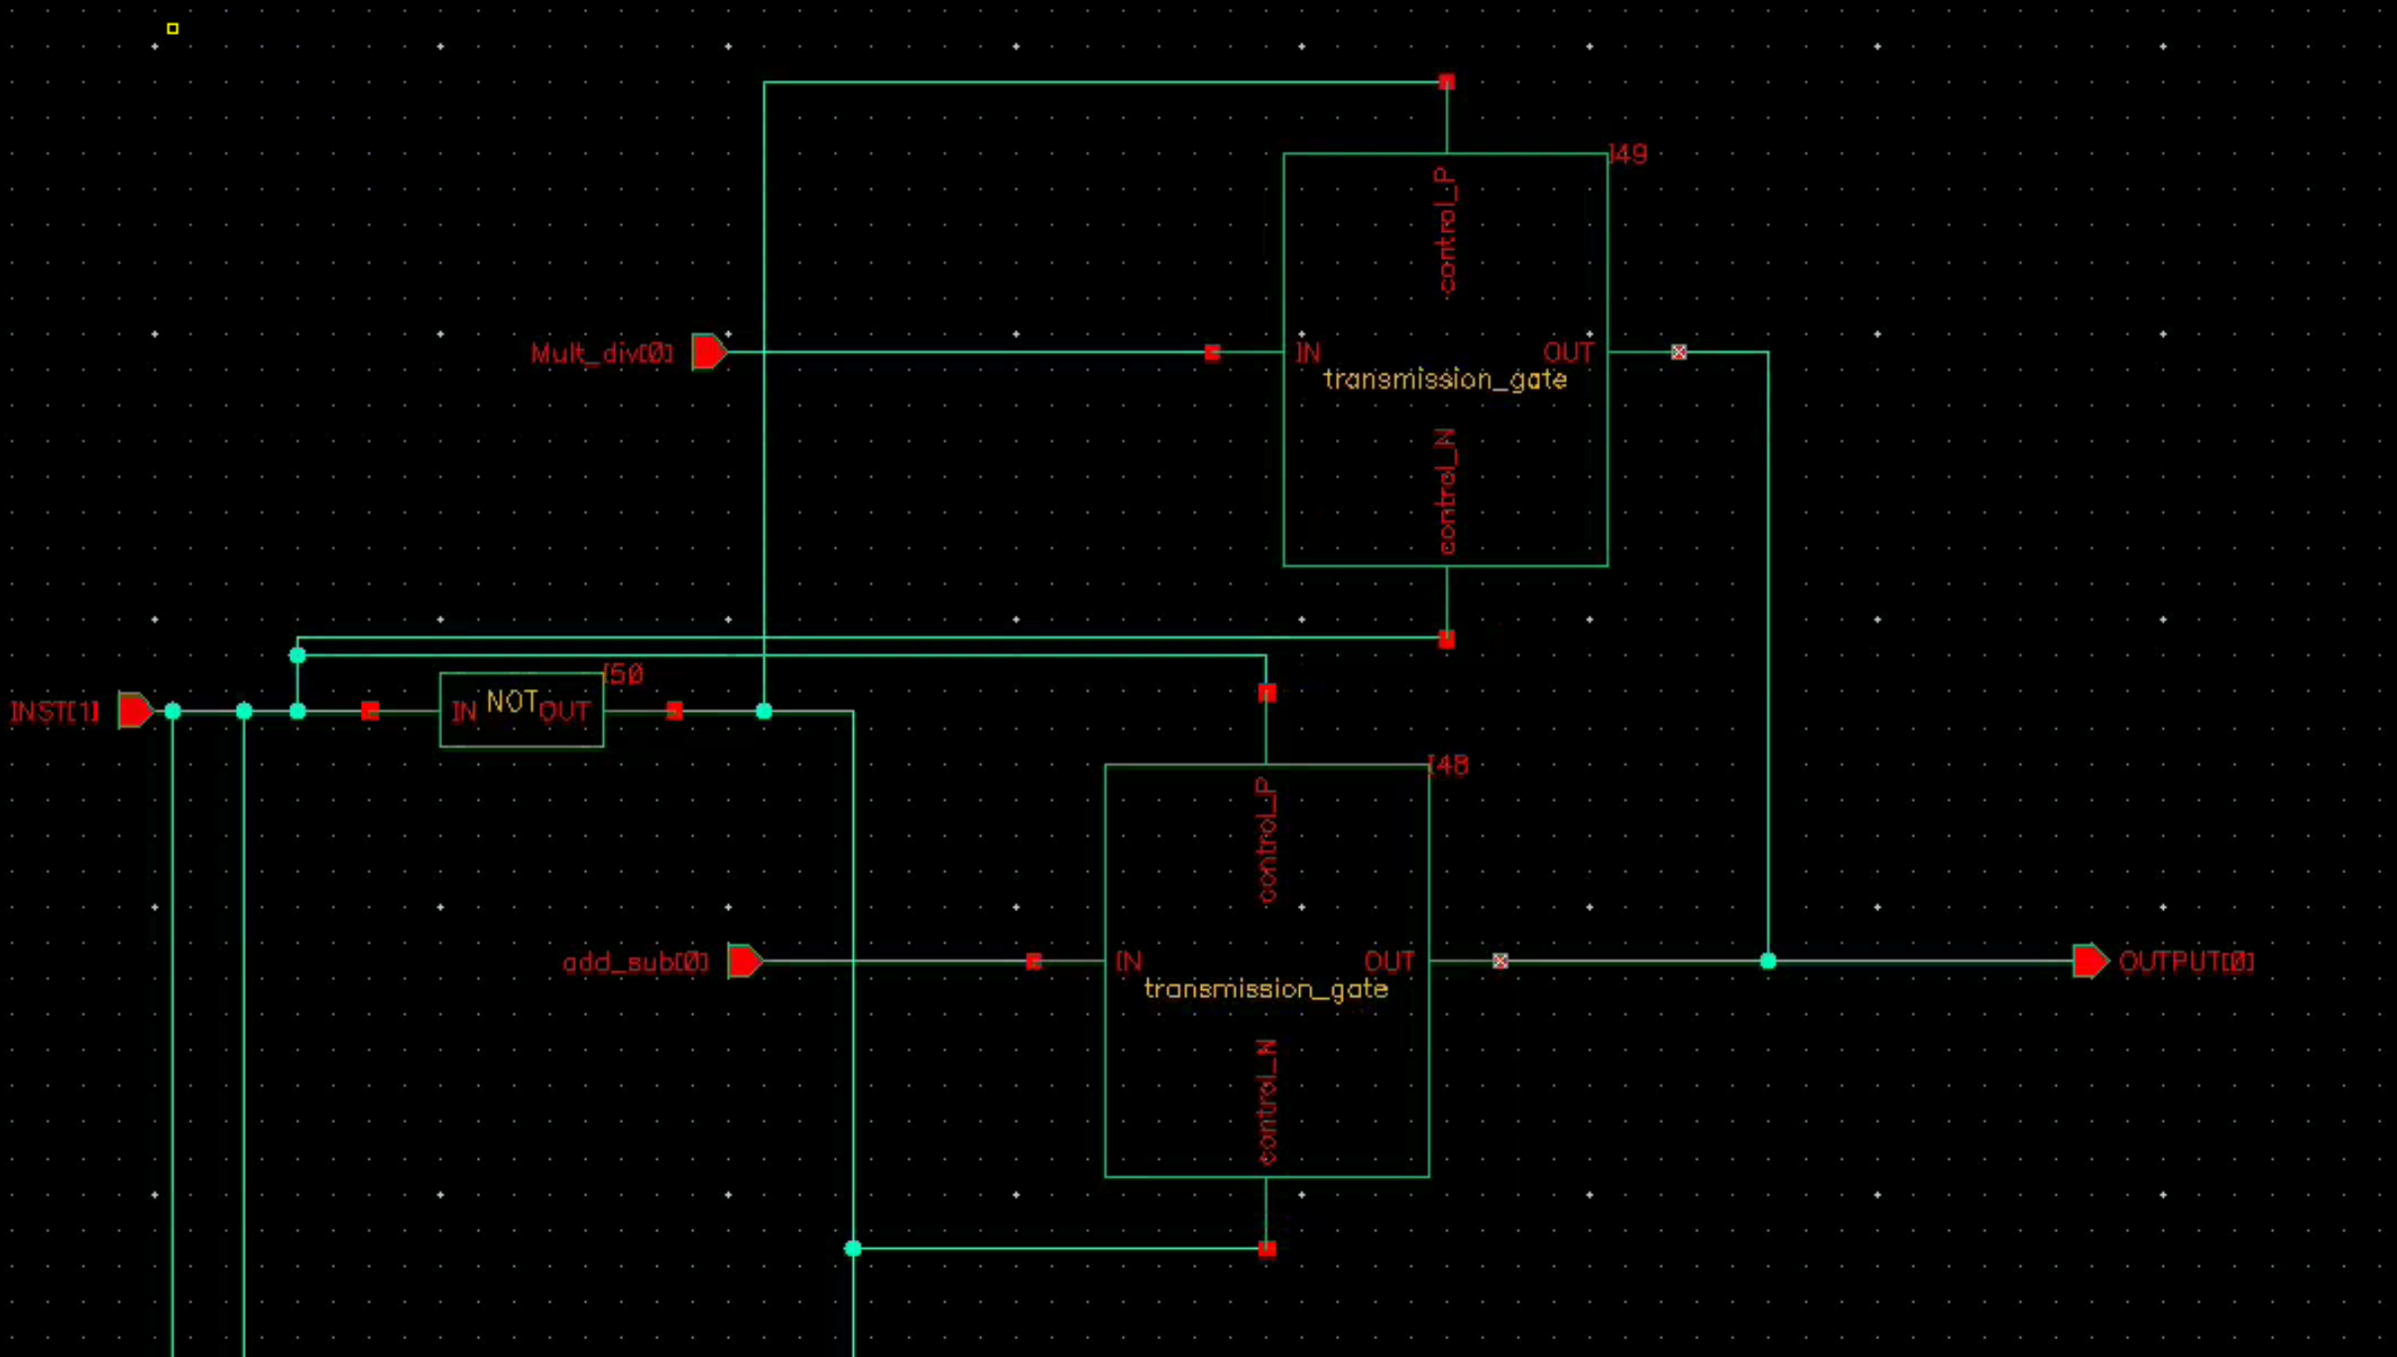
Optimization
Use transmission gate instead of static CMOS gate to reduce the number of transistors. E.g. use transmission gate to build a 2x1 MUX(without buffers) requiring 6 transistors instead of 16 transistors with static CMOS gate.
transmission gates are used in MUX_ADD_Mult module

Slide 9
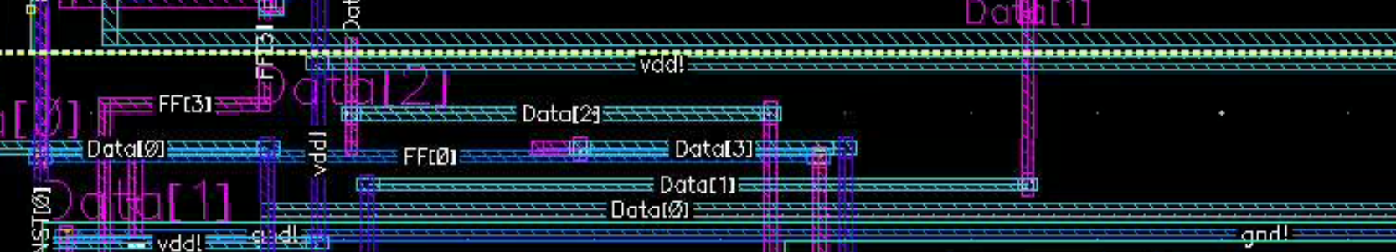
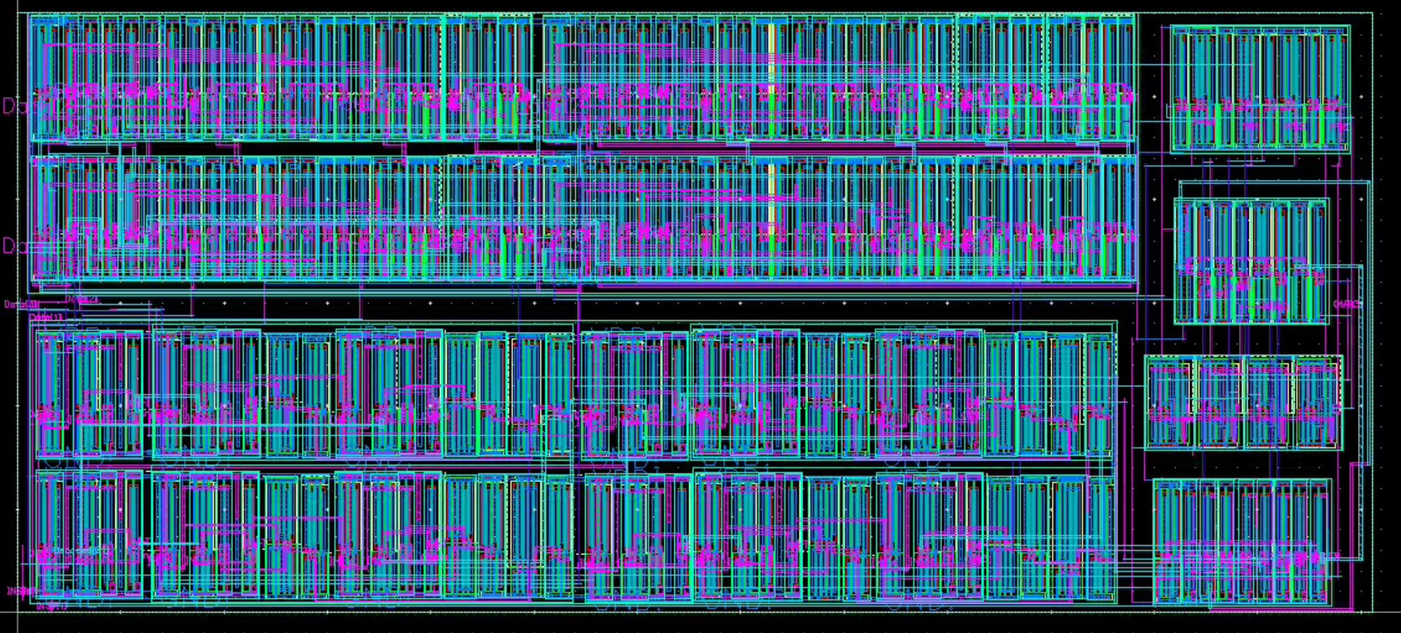
Optimization
M3 interconnection layer are used in subcircuit, M4 layer are used in top level; Upper metal layer reduces resistance when the wire has long distance.

Slide 10
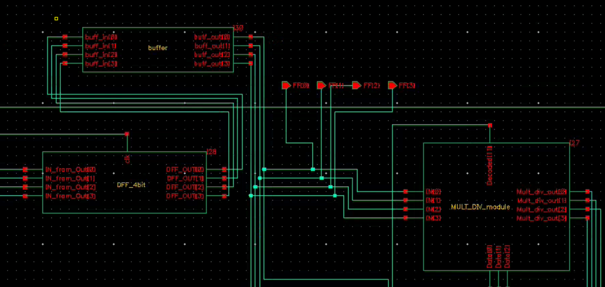
Optimization
Buffer module between Flipflop module and computation modules is added to reduce delay, and it improves the circuit speed (clock cycle) in HSPICE simulation.

